Slide 1

DEE 4544 DIGITAL ELECTRONICS Chapter 6 & 7: Synchronous and asynchronous State Machine Design
By : Dr. Noraisyah Tajudin
Email: noraisyahtajudin@lincoln.edu.my
Faculty of Engineering
Lincoln University College (LUC)
LECTURE 6
DATE : MAY 2024

Slide 2
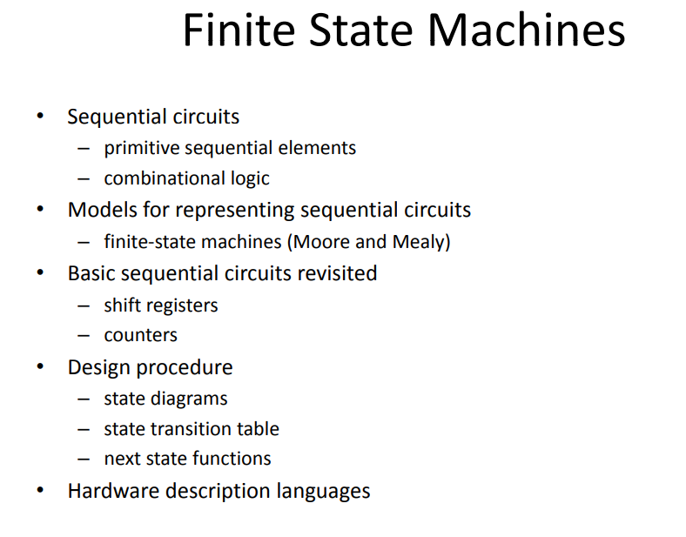

Slide 3
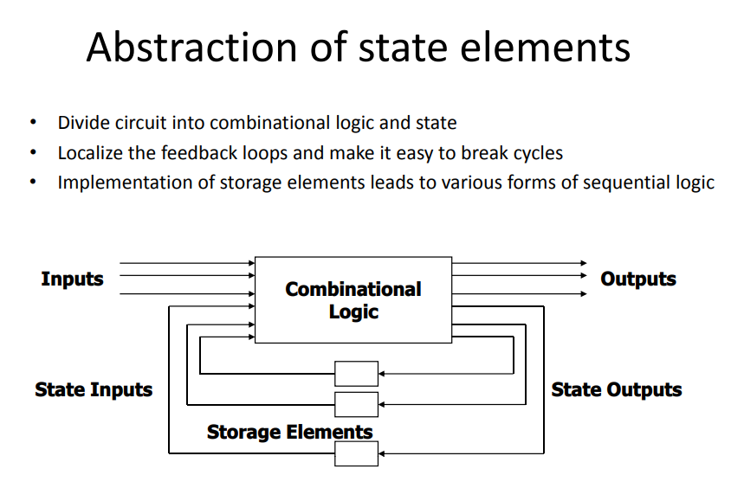

Slide 4
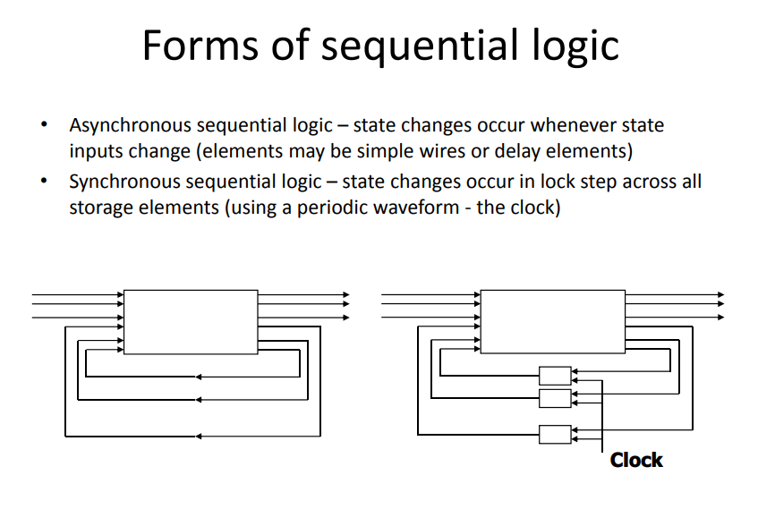

Slide 5
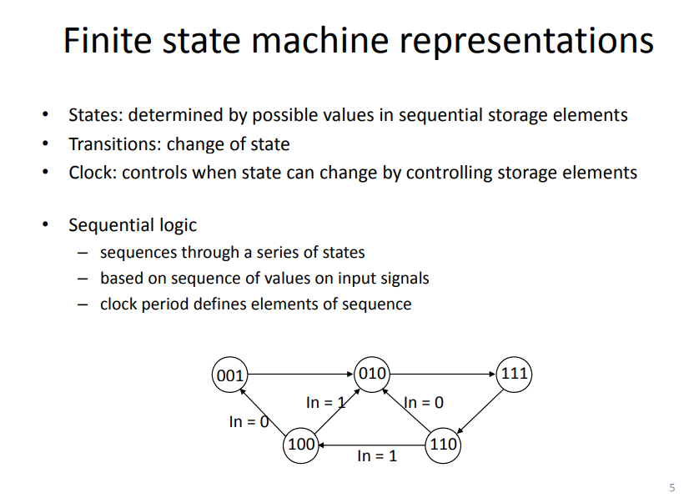

Slide 6
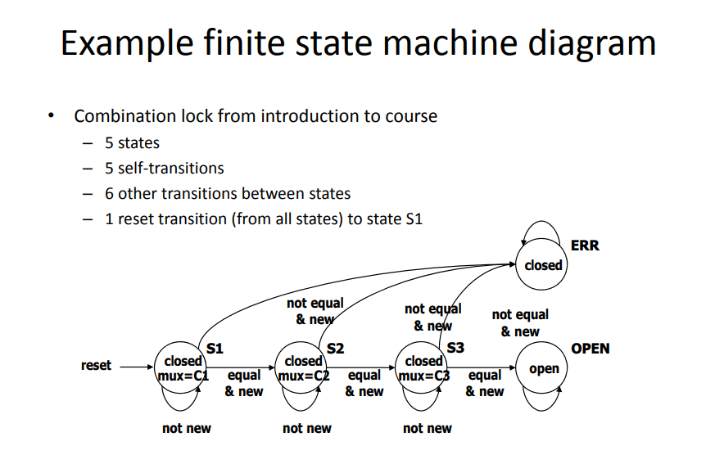

Slide 7
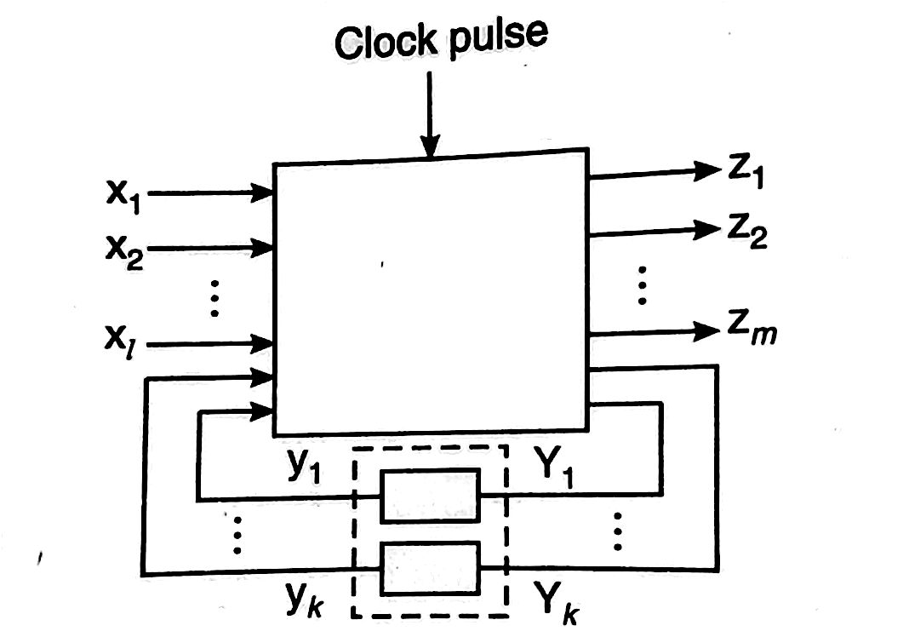
The State Machine:
A state machine or finite state machine (FSM) is an abstract model describing the synchronous sequential machine.

Slide 8
Models of representing sequential circuits
The synchronous or clocked sequential circuits are represented by two models.
1. Moore circuit: In this model, the output depends only on the present state of the flip-flops.
2. Mealy circuit : In this model, the output depends on both the present state of the flip-flop(s) and the input(s).

Slide 9
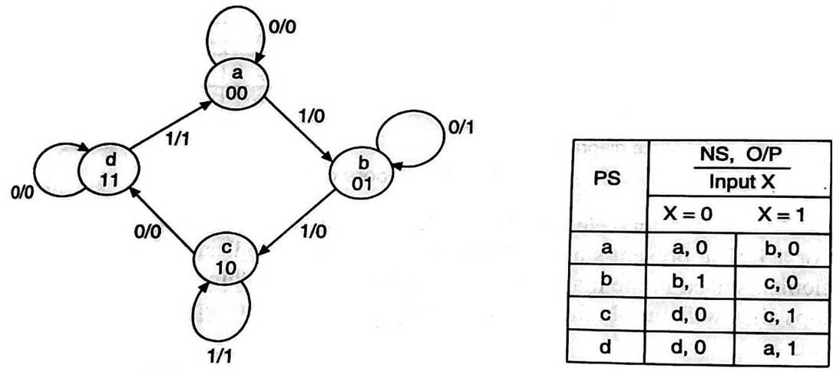
State Diagram
The state diagram or state graph is a pictorial representation of the relationships between the present state, the input, the next state, and the output of a sequential circuit, i.e. the state diagram is a pictorial representation of the behaviour of a sequential circuit.
State diagram and state table using mealy machine

Slide 10
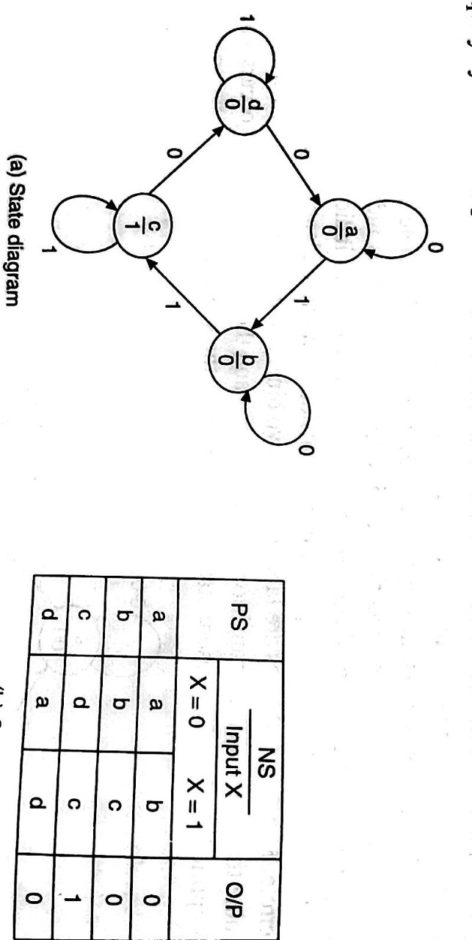
State Table
Even though the behaviour of a sequential circuit can be conveniently described using a state diagram, for its implementation the information contained in the state diagram is to be translated into a state table. The state table is a tabular representation of the state diagram.

Slide 11
State Reduction
The state reduction technique basically avoids the introduction of redundant states.
It reduces no. of FFs and logic gates.

Slide 12
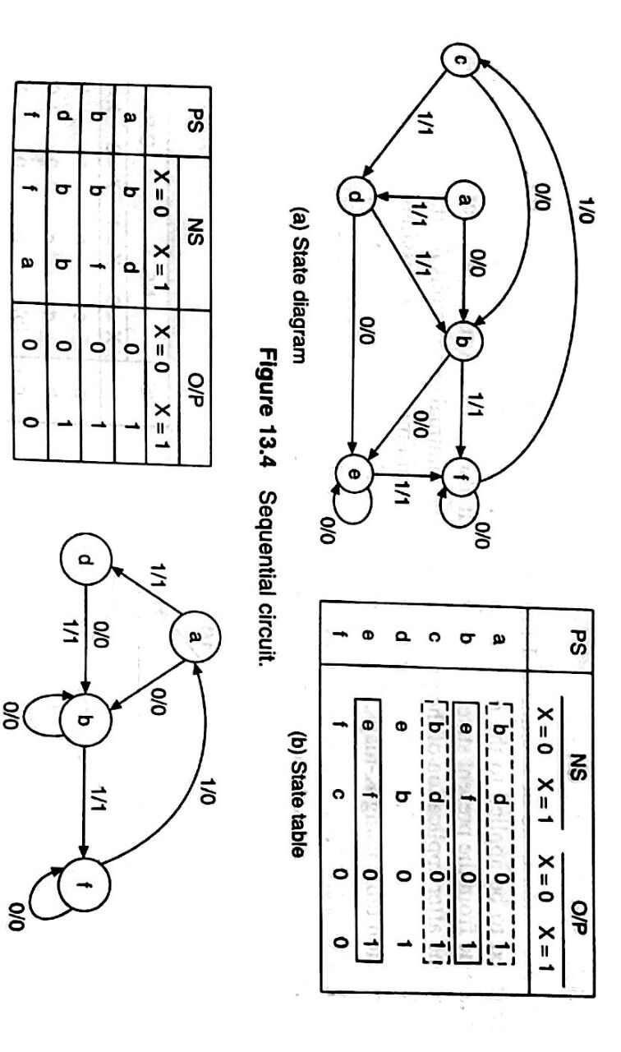

Slide 13
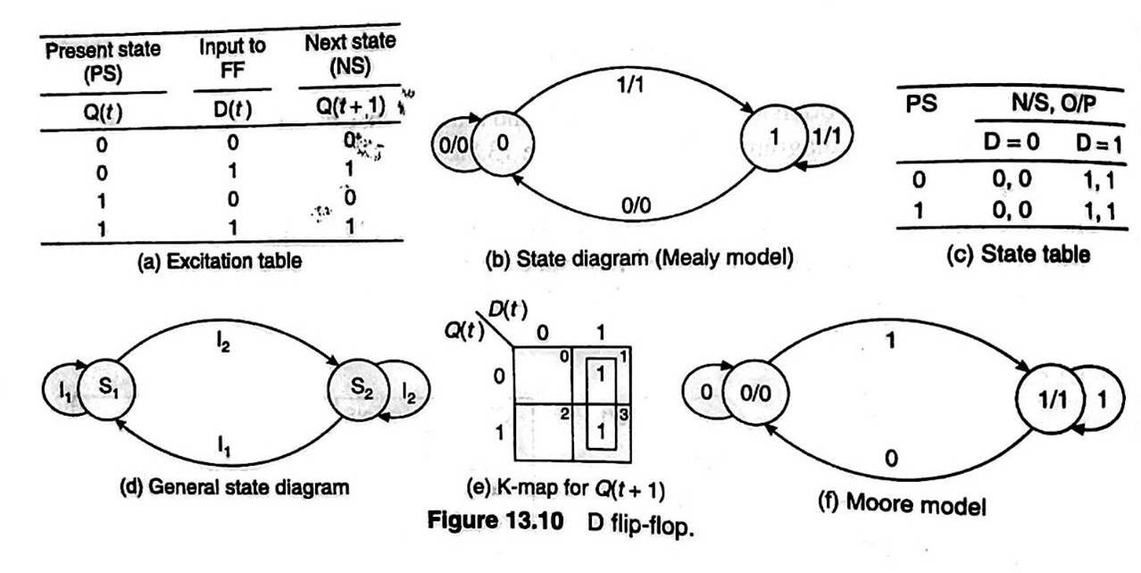
Memory Elements
D flip flop

Slide 14
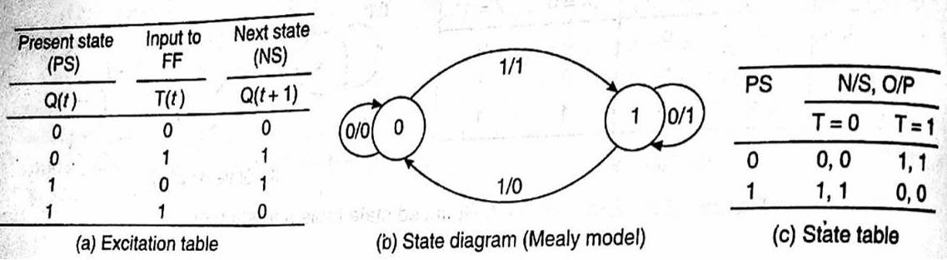
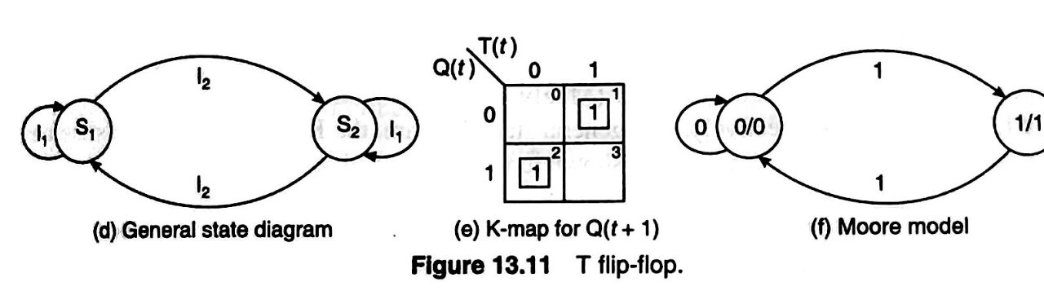
T flip flop

Slide 15
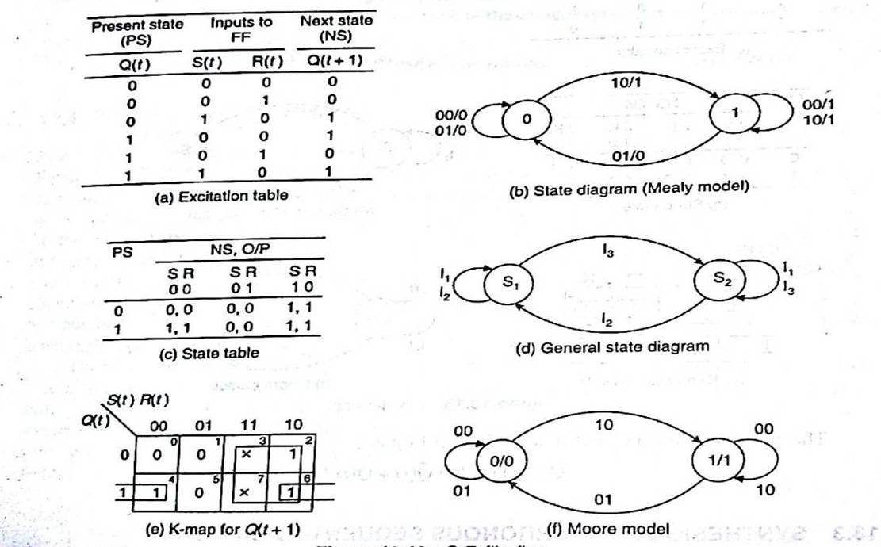
S R flip flop

Slide 16
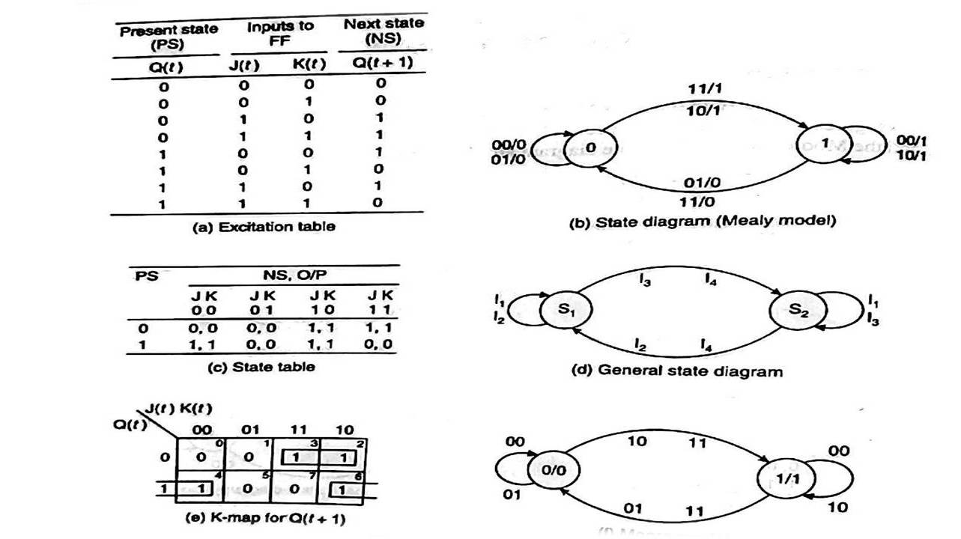
J K flip flop

Slide 17
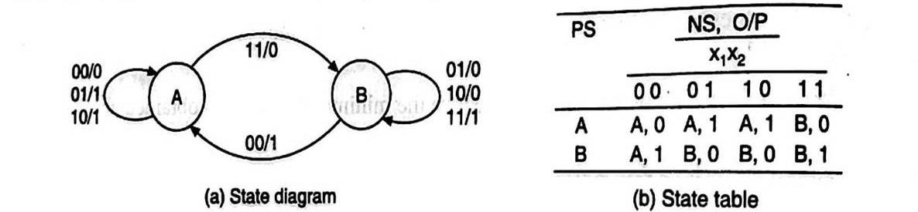
Serial binary adder
Step 1. Word statement of the problem
Step 2. State diagram
Step 3. State table.

Slide 18
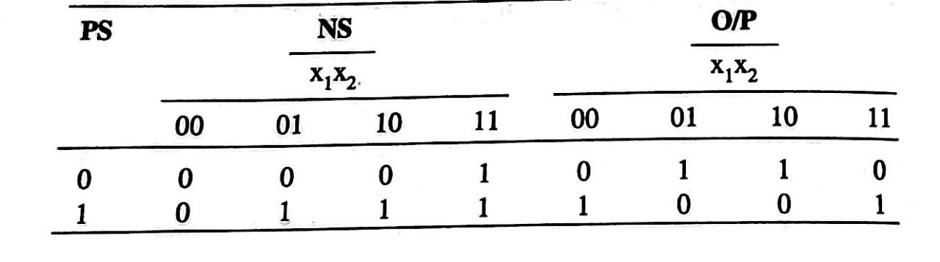
Step 4. Reduced standard form state table.
Step 5. State assignment and transition and output table:
Step 6. & 7. Choose type of flip-flops and form the excitation table and solve the K-maps and minimal expressions 2

Slide 19
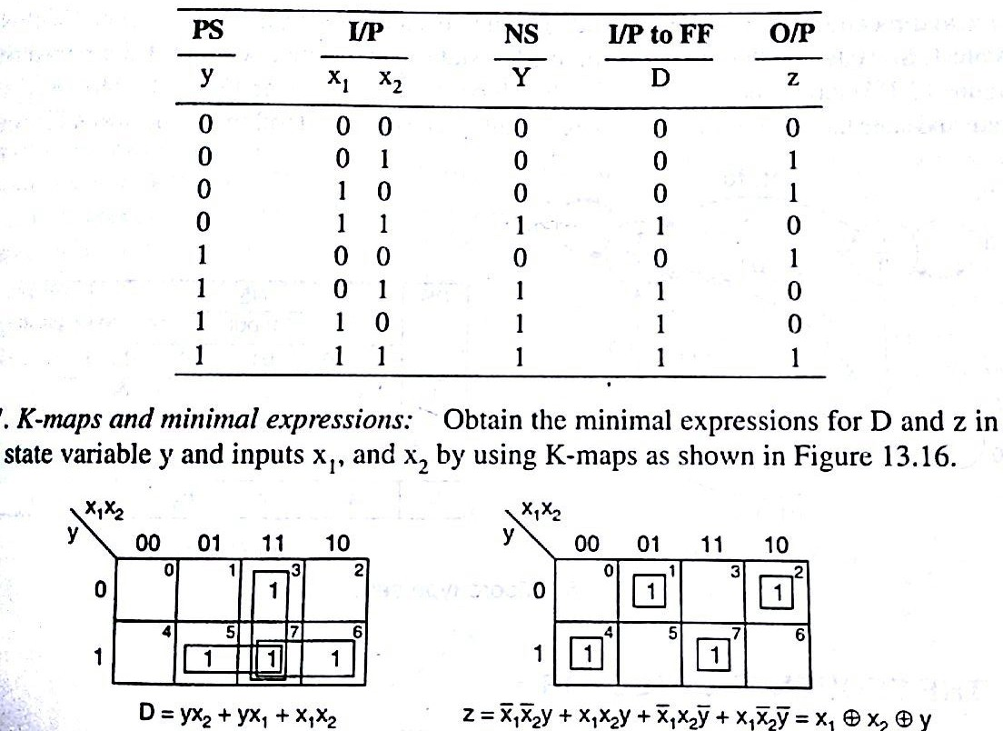

Slide 20
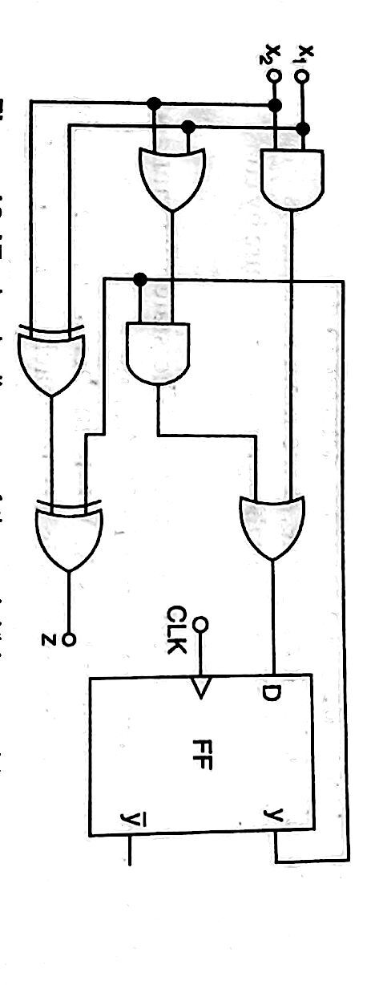
Step 8. Implementation

Slide 21
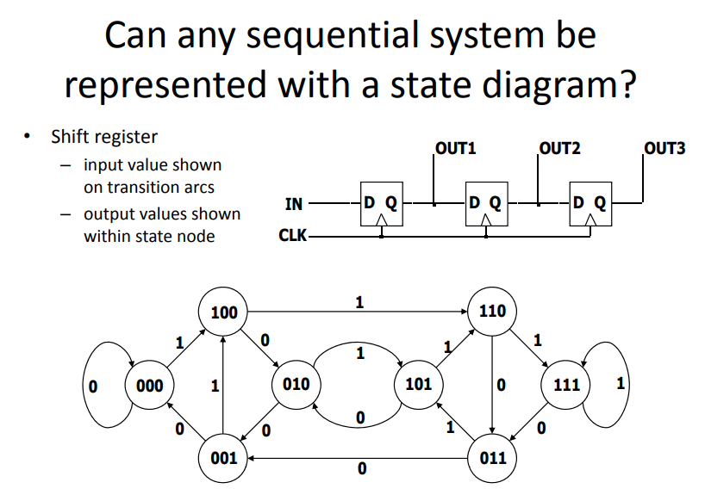

Slide 22
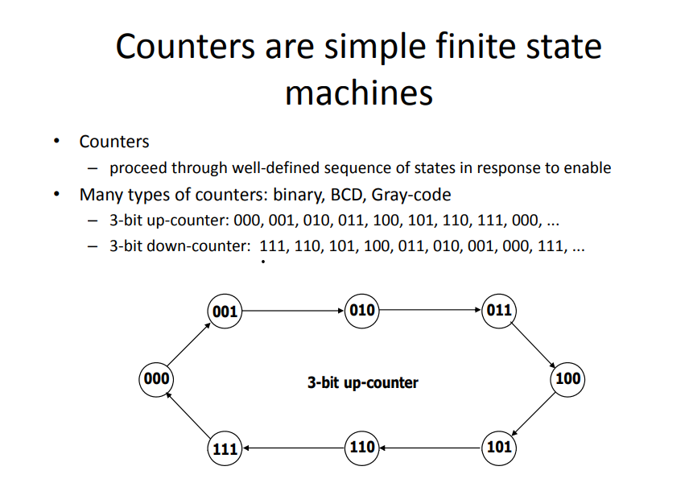

Slide 23
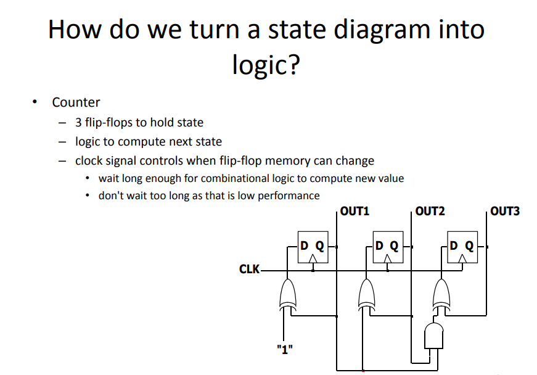

Slide 24
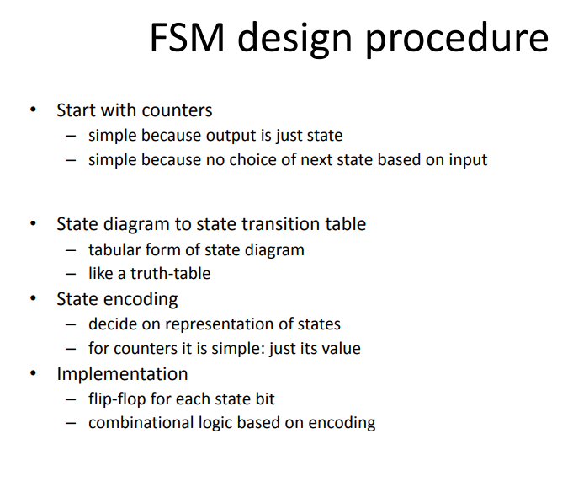

Slide 25
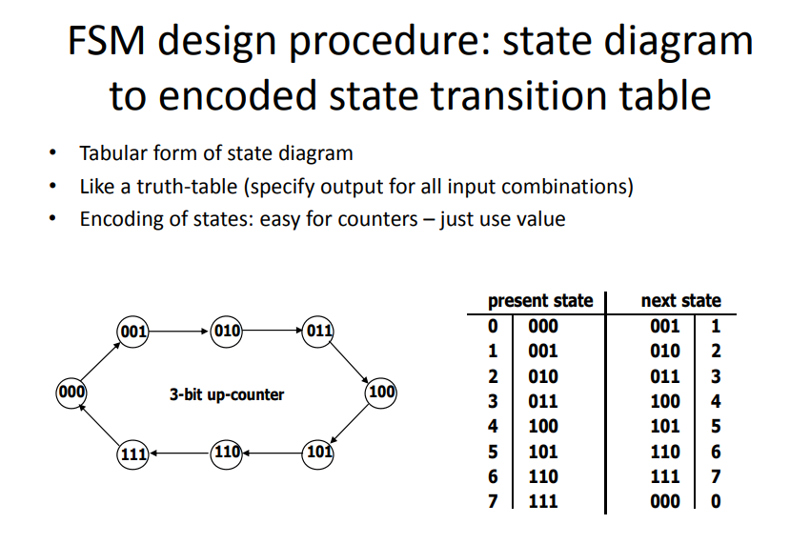

Slide 26
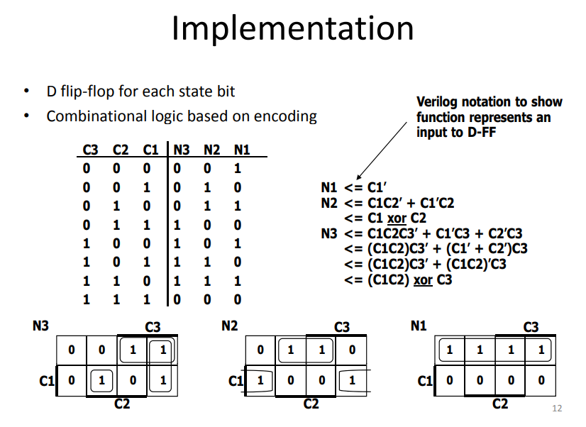

Slide 27
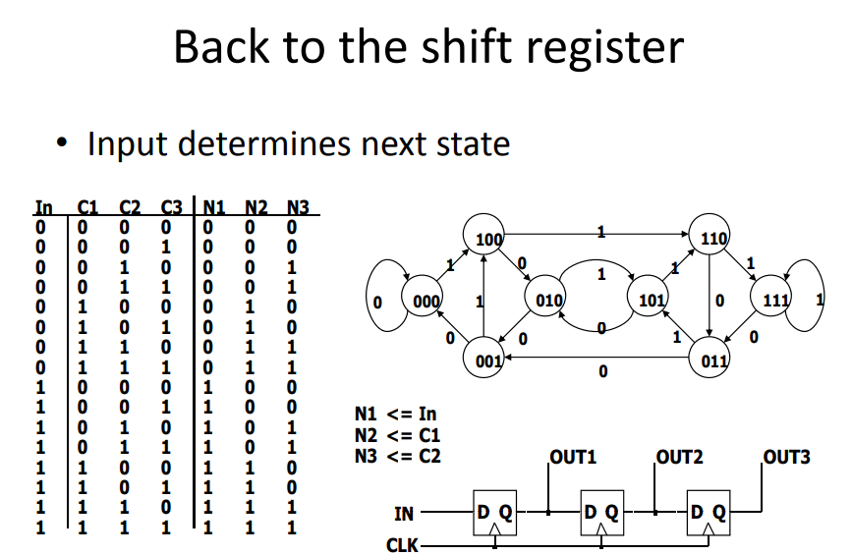

Slide 28
Thank You

